Slide 1
Yunga GUERNSEY BIODIVERSITY Badge

Slide 2
Who are YUNGA ?
YUNGA seeks to empower children and young people to have a greater role in society, raise awareness and become active agents of change.
Youth and United Nations Global Alliance
They have a series of badges based on the sustainable development goals.
Young people complete these badges and think about how they can change their behaviour for the better.
In Guernsey we are offering only one YUNGA badge at the moment and this is the Biodiversity badge.

Slide 3
Biodiversity badge
This cloth badge is gained by appreciating, learning about and being kind to the Guernsey environment
Some young people are already doing things to help the environment such as beach cleans and making bug hotels.
This badge will allow you to get recognition for your work.
The badge is for school age young people 5-18 years. Adults can help primary school children. Older teens can help younger children

Slide 4
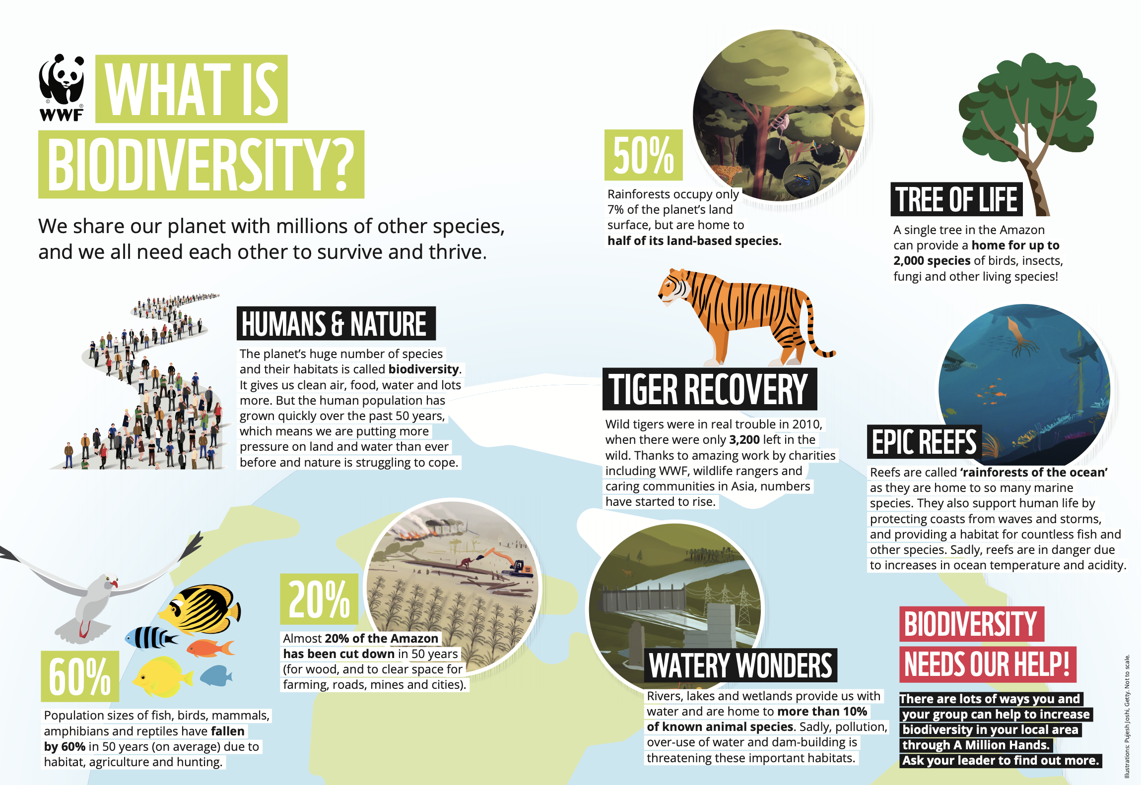

Slide 5
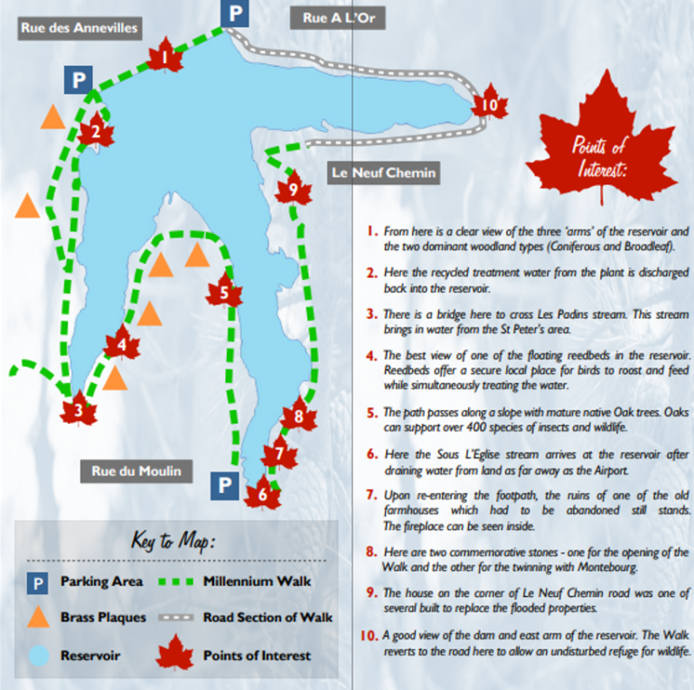
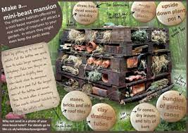
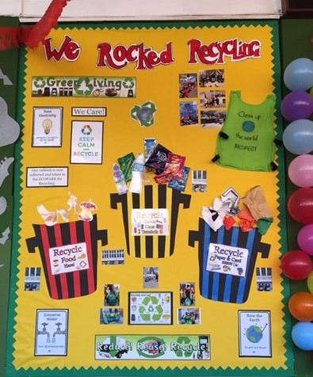
What do I need to do?
Do 8 environmental things: 2 from each category of Land Air Water World (Environment)
Individual/family activity
If you have an idea for an activity, ask fragileguernsey who will give it a category and then it will count.
School activity
Organised Activity
Find organized events on the calendar at www.fragileguernsey.gg/yungaguernsey

Slide 6
How do I submit my work?
This may vary between schools. Your school may set up a school wide team and have a YUNGA coordinator- if you do that then your YUNGA coordinator only needs to tell fragile guernsey how many badges they need. Other wise YUNGA GUERNSEY will coordinate a google page for a young person
You upload pictures of you doing the event or activity and write a short sentence about what you did.
After 8 events you write your concluding thoughts about what you have learnt and what you will change about your behaviour to be kinder to the planet

Slide 7
How do I get my badge ?
Badges and certificates will be sent to schools in the same way the Eisteddfod awards are sent and the school will present them to you.

Slide 8
Partners
SUPPORTERS

